Slide 1
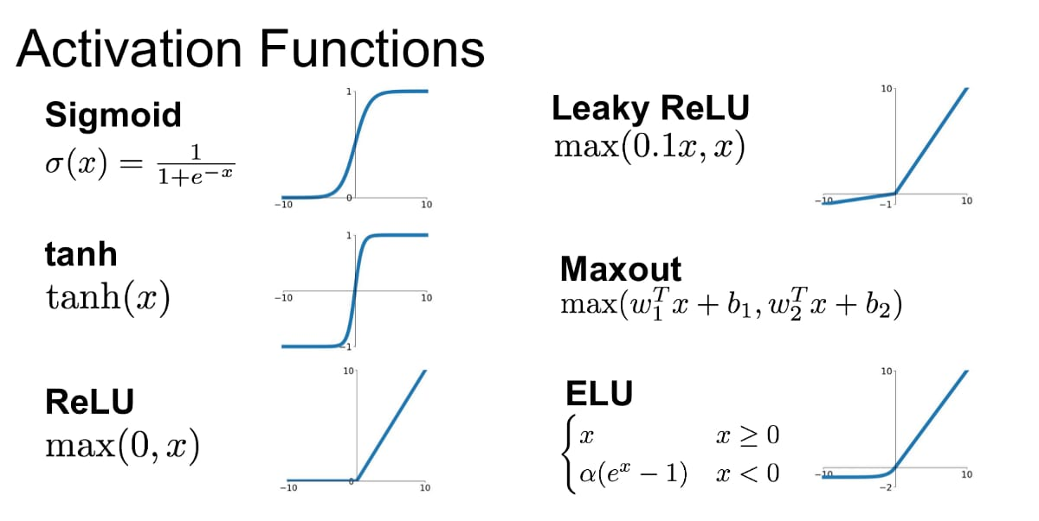

Slide 2
Imagine an Image is a Picture Grid
Think of an image as a grid made up of tiny squares called pixels, each with a value that represents brightness or intensity.
For example, in a 150x150 grayscale image, you have 150 rows and 150 columns of pixels, with each pixel having just one number to show how light or dark it is (because it's grayscale).

Slide 3
Layer-by-Layer Explanation
Conv2D Layer:
What does it do? It scans the image by applying filters (or small windows) across the pixels to find features (like edges, shapes, or patterns).
Filter (32 filters, 3x3 size): Think of a filter as a magnifying glass that looks at a small 3x3 area of the image at a time. In this case, 32 different filters will scan different parts of the image to find patterns.
Strides = 1: This means the filter moves one pixel at a time across the image.
Padding = 'same': This keeps the image size the same by adding extra borders around the edges so that the filter can also process the border pixels.
Activation = 'relu': After scanning, we use the ReLU activation function to keep only positive values (i.e., patterns that matter) and turn negative values to zero.
Example: Imagine you're scanning a photo with a magnifying glass, trying to find straight lines.
The magnifying glass looks at small 3x3 sections of the photo and says, "Hey, I found a line here!" You then write down that information in a new image.

Slide 4
2. Batch Normalization:
What does it do? It normalizes (or adjusts) the values of the image features after the convolution, making the training more stable.
Example: Think of this as adjusting the brightness of the entire picture so that it’s not too dark or too bright, making it easier to see patterns.

Slide 5
3. MaxPool2D Layer:
What does it do? This layer reduces the size of the image while keeping the most important information.
(2x2) filter: It looks at 2x2 blocks of pixels in the image and keeps only the largest value from each block.
Strides = 2: This means the filter moves 2 pixels at a time.
Padding = 'same': This ensures that the output size stays consistent, even near the borders.
Example: Imagine you divide a picture into small 2x2 squares and in each square, you only keep the most interesting detail (like the sharpest or darkest line). This way, you make the picture smaller but keep the essential parts.

Slide 6
In 2nd layer:
This layer continues to look for more complex features in the image by using 64 filters (each 3x3 in size).
Example: Imagine you’ve already used magnifying glasses to identify the general outlines of shapes in a photo. Now you want to look deeper. These 64 new magnifying glasses will each look for more specific details like curves, patterns, or textures inside the shapes, helping you to understand the image better.
Dropout Layer (0.1):
What does it do? During training, this layer randomly "turns off" 10% of the neurons (connections) to prevent overfitting, where the model might memorize the training data instead of learning useful patterns.
Example: Think of this as forcing yourself to ignore 10% of the details in the picture for a while.
This way, you don’t get too fixated on small, irrelevant features, and you’ll learn to see the big picture better.
These process helps the neural network gradually focus on the critical patterns in the chest X-ray image to detect pneumonia.

Slide 7
Model is where the network makes decisions based on all the features it has learned so far.
Fully Connected Layers (Dense Layers) with Dropout :
Dense Layer (units = 128, activation = 'ReLU’):
What does it do? This layer takes all the features learned by the previous layers and connects them to 128 neurons. Each of these neurons processes the input features to learn more complex patterns.
ReLU activation: This activation keeps only the positive values and sets the negative ones to zero, helping the network focus on important features.
Example: Imagine you've collected a bunch of clues from an image (edges, textures, patterns, etc.).
Now, you pass these clues to a group of detectives (128 neurons), each trying to solve the puzzle of whether the image shows pneumonia or not.
Every detective (neuron) analyzes the clues in a different way, trying to make sense of the information.

Slide 8
Dropout Layer (0.2):
What does it do? This layer randomly "turns off" 20% of the neurons during training to prevent the network from overfitting, which happens when the model memorizes the training data instead of learning useful patterns.
Example: Imagine you're forcing 20% of the detectives to step aside and not participate in analyzing certain clues. This way, the remaining detectives have to work harder to analyze the important clues.
This ensures the model doesn't rely too much on just a few neurons and can generalize better.

Slide 9
Dense Layer (units = 1, activation = 'sigmoid’):
What does it do? This final layer has only 1 output neuron, and it uses the sigmoid activation function to give a probability between 0 and 1.If the output is close to 1, it predicts that the image shows pneumonia.
If the output is close to 0, it predicts that the image is normal (no pneumonia).
Example: After all the detectives (neurons) have analyzed the clues, one final judge (this last neuron) makes the final decision: Is it pneumonia or not?
The judge gives a probability, like saying, "There's a 90% chance this X-ray shows pneumonia."

